Slide 1
Battery Technology
Battery is a combination of two or more electrochemical cells (converts chemical energy into electrical energy).
A cell consists of two electrodes with an electrolyte placed between them. The negative electrode is known as the cathode, while the positive electrode is known as the anode.
Today many cells are enclosed in a special container, and there is an element known as a separator placed between the anode and cathode. This is porous to the electrolyte and prevents the two electrodes from coming into contact with each other.
Batteries are becoming more widely used. As the use of portable and mobile equipment increases, so does the use of battery technology.
These range from the established non-rechargeable technologies such as zinc-carbon and alkaline batteries to rechargeable batteries that have moved from Ni-Cd through Ni-MH cells to the newer lithium ion rechargeable batteries.

Slide 2
Primary and Secondary cells
Although there are many different types of battery, there are two main categories of cell or battery that can be used to provide electrical power. Each type has its own advantages and disadvantages and therefore each type of battery is used in different applications, although they can often be interchanged:
Primary batteries: Primary batteries are essentially batteries that cannot be recharged. They irreversibly transform chemical energy to electrical energy. When the chemicals within the battery have all reacted to produce electrical energy and they are exhausted, the battery or cell cannot be readily restored by electrical means.
Secondary batteries: Secondary batteries or secondary cells are different to primary ones in that they can be recharged. The chemical reactions within the cell or battery can be reversed by supplying electrical energy to the cell, restoring their original composition.

Slide 3
[I] Lead acid battery
Positive plate: This is covered with a paste of lead dioxide.
Negative plate: This is made of sponge lead.
Separator: This is an insulating material between the two plates, but it allows the electrolyte and the ions into it to enable conduction without the two plates touching.
Electrolyte: This consists of water and sulphuric acid
These constituents are all contained within a plastic container which acts to keep the electrolyte in and the battery together.
The overall battery will normally consist of several cells placed in series to give the required voltage as each cell is capable of providing an EMF of 2.1 volts.
In order to enable the basic lead acid cell to produce a voltage, it must first receive charge. The voltage applied to provide this must be greater than the 2.1 volts to enable current to flow into the cell. If it were less than this, charge would actually flow out of it.
Once charged, the cell or battery will be able to provide charge to external circuits, often operating over several hours dependent upon the drain on the cell or battery.

Slide 4
Lead Acid Battery Advantages
Mature technology
Relatively cheap to manufacture and buy (they provide the lowest cost per unit capacity for rechargeable cells)
Large current capability
Can be made for a variety of applications
Tolerant of overcharging
Wide range of sizes and specifications available
Many producers worldwide

Slide 5
Lead Acid Battery Disadvantages
Fails after a few years of use lifespan (typically 300 - 500 cycles)
Cannot always be used in a variety of orientations
Corrosive electrolyte (can cause burns to people and corrosion on metalwork)
Lead is not environmentally friendly
Acid needs disposing of with care
Not suitable for fast charging
Must be stored in charged state once electrolyte introduced
Typical charging efficiency only around 70%

Slide 6
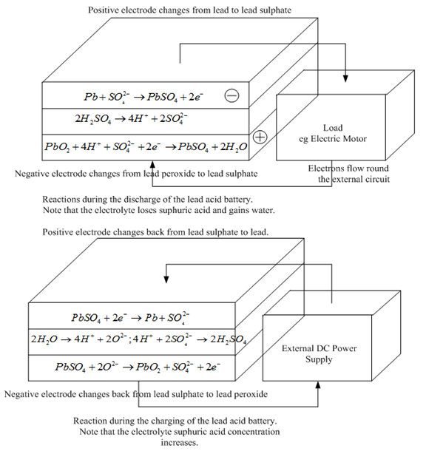
Diagram

Slide 7
[II] Fuel Cell
Fuel cells were invented in about 1840, but they are yet to really make their mark as a power source for electric vehicles.
However, this might be set to change over the next 20 or 30 years.
Certainly most of the major motor companies are spending very large sums of money developing fuel cell powered vehicles.
The basic principle of the fuel cell is use of hydrogen fuel to produce electricity in a battery-like device.
The main components of fuel cell are:
Anode comprising of fuel
An electrolyte (solution of H₂SO₄ and KOH)

Slide 8
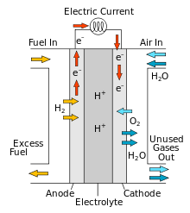
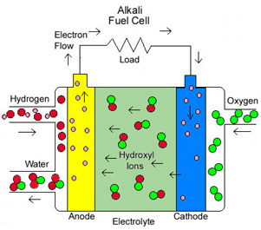

Slide 9
To understand this we need to consider the separate reactions taking place at each electrode. These important details vary for different types of fuel cell, but if we start with a cell based on an acid electrolyte, we shall consider the simplest and the most common type.
At the anode of an acid electrolyte fuel cell the hydrogen gas ionizes, releasing electrons and creating H⁺ ions (or protons).
This reaction releases energy. At the cathode oxygen reacts with electrons taken from the electrode and H⁺ ions from the electrolyte to form water.

Slide 10
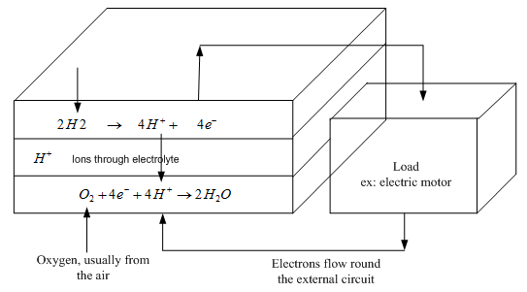
The reactions given above may seem simple enough, but they do not proceed rapidly in normal circumstances.
Also, the fact that hydrogen has to be used as a fuel is a disadvantage.
To solve these and other problems many different fuel cell types have been tried.
The different types are usually distinguished by the electrolyte that is used, though there are always other important differences as well.

Slide 11
Limitations:
Storage of fuel and oxidant.
Electrolytes and electrodes are costly
Gives DC output and should be converted into AC.
Advantages:
High power efficiency approximately 75%
Eco-friendly
Space required for fuel cell is less.
Produce DC for a long time.

Slide 12
[III] Nickel Cadmium Cell
It is rechargeable secondary cell. It consist of cadmium as negative electrode (anode) and nickel oxide as positive electrode (cathode) and potassium hydroxide as electrolyte.
Anode: Cadmium
Cathode: NiO(OH)
Electrolyte: KOH

Slide 13
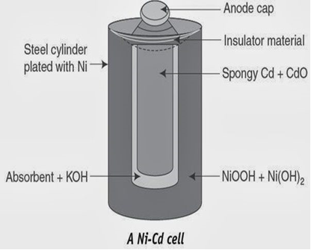
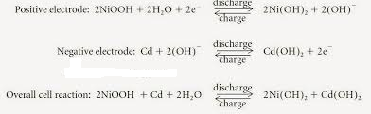

Slide 14
Advantages
Low internal resistance (less than half the equivalent Ni-MH cells)
High rate charge and discharge rates possible
It produces potential of 1.4 V and has longer life than lead storage cell.
Ni-Cd Cell is used in medical instrument, calculator flash light.
Tolerates deep discharges can be deep cycled.
Wide temperature range (Up to 70°C)
Typical cycle life is over 500 cycles.
Charging process is strongly endothermic-the battery cools during charging. This makes it possible to charge very quickly, Rapid charge typically 2 hours, but can be as low as 10 to 15 minutes.
The coulombic efficiency of nickel cadmium is over 80% for a fast charge but can drop to below 50% for slow charging.
The electrolyte is commonly available, low cost potassium hydroxide KOH.

Slide 15
Limitations
A major drawback of this technology is its susceptibility to memory effect.
Ni-Cd batteries are also prone to damage by overcharging.
Low cell voltage of 1.2 Volts compared with primary alkaline cells 1.5 Volts and only quarter of the capacity of the alkaline cells.
Self-re-sealing safety vents must be incorporated to prevent damage due to overheating and pressure build up.
Cadmium is a high cost heavy metal and its use in consumer products is now deprecated on environmental grounds.
Originally, the terms memory effect or memory problem was coined to describe a cyclic memory problem where the Ni-Cd battery would "remember" the amount of discharge for previous discharges and limit the recharge life of the battery.
The problem is less prevalent with modern Ni-Cd batteries, which are designed to avoid cyclic memory issues.

